Slide 1



Slide 2

Defense Colonies Management System
Supervised by:
Mam Tahira Sadaf
Group Members:
Mian Farman Ellahi (FA16-BCS-071)
Nitasha Tariq (FA16-BCS-049)
Usman Ali (FA16-BCS-060)
Department of Computer Science
COMSATS University Islamabad, Attock Campus

Slide 3
Outline
________ _
Introduction
Problem statement
Objectives
Related Work / Applications
Methodology
Modern tools
Technologies
Block diagram
Context diagram
Activity diagrams
Use case diagrams
Sequence diagrams
Graphical user interfaces
References
____________ __________________

Slide 4
Introduction
________ _
ERP system designed for managing record of defense colonies.
It contains seven sub-system; each sub-system is designed for managing each department present in colony.
It contained centralized database and that database is placed on online server.
Guest authentication android application is developed for guest arrival permission in colony.
____________ __________________

Slide 5
Problem Statement
__________ _____
Defense colonies management system is designed to provide automated methods for saving the departmental records of defense colonies, so that manual record of colony departments are handled separately and without any data loss. By using this system, record of employee in colony is searched with single mouse click, without any wastage of time.
_______________ _____________

Slide 6
Objectives
________ _______
Record keeping.
Interdepartmental communication.
User Friendly Interfaces.
Admin Portals.
Employee Profile ( user profile).
Staff portals.
Record from all the departments is shown in single click
Guest location tracking.
Guest arrival permission through android application.
____________ __________________

Slide 7
Related Work /Applications
________ _______
Housing society management solution
Uliving
Gatekeeper by ADDA- Apartment Complex Gate Mgmt
Wow security sentinel: Gate & visitors management
_______________________________

Slide 8
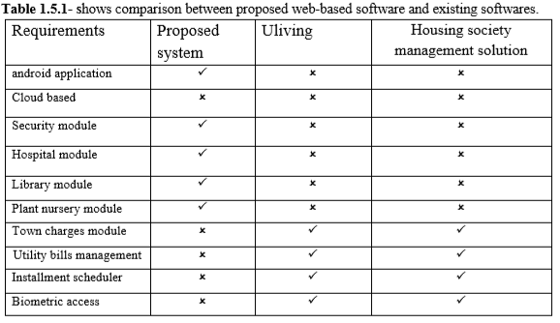
Related Work /Applications (continue)
_____ __________
_______________________________

Slide 9
Related Work /Applications (continue)
_________ _
Comparison between proposed Android application and existing Android applications.
Requirements | Proposed android application | Gatekeeper by ADDA-Apartment Complex Gate Mgmt | Wow security sentinel: Gate & visitors management
Guest location tracking | ✓ | ✗ | ✗
Security code generation | ✓ | ✗ | ✗
Guest/visitor portal | ✓ | ✗ | ✗
Security guard portal | ✗ |   ✓ | ✓
_______________________________

Slide 10
Methodology
_______ _______
We use “AGILE DEVELOPMENT METHODOLOGY” for developing our project because the system is developed in a series of versions or increments with the involvement of stakeholders in specification of version and system evaluation.
_______________________________

Slide 11
Modern tools
____________ _
Tools | Rationale
Brackets (version 1.13) | For creating web pages
Star Uml (version 2.8.1) | Project diagrams
DIA | Project diagrams
MS Word (2010) | documentation
MS PowerPoint (2010) | presentation
Android Studio (version 3.5.3) | For making android application
_______________________________

Slide 12
Technologies
_____________ _
Technology | Rationale
SQL(version 2013) | Query Language
css | Web page designing
Firebase database | Database for android application
Html, PHP, JS | Web pages development
000.webhosting | For hosting website on server
_______________________________

Slide 13
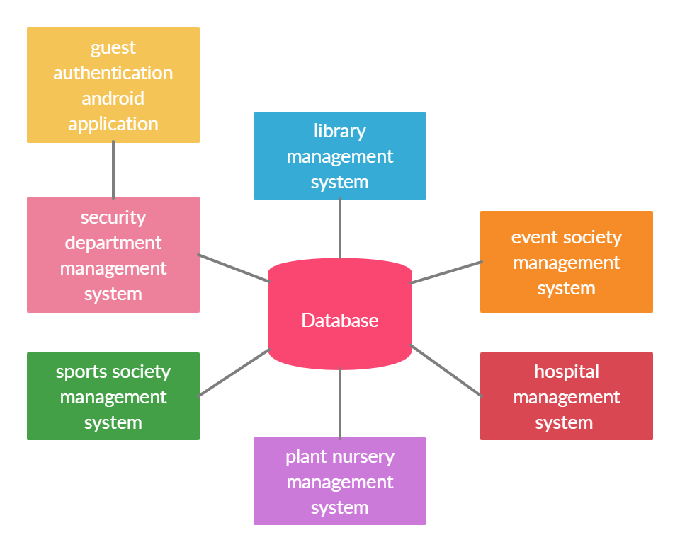
Block diagram
_____________ _
_______________________________

Slide 14
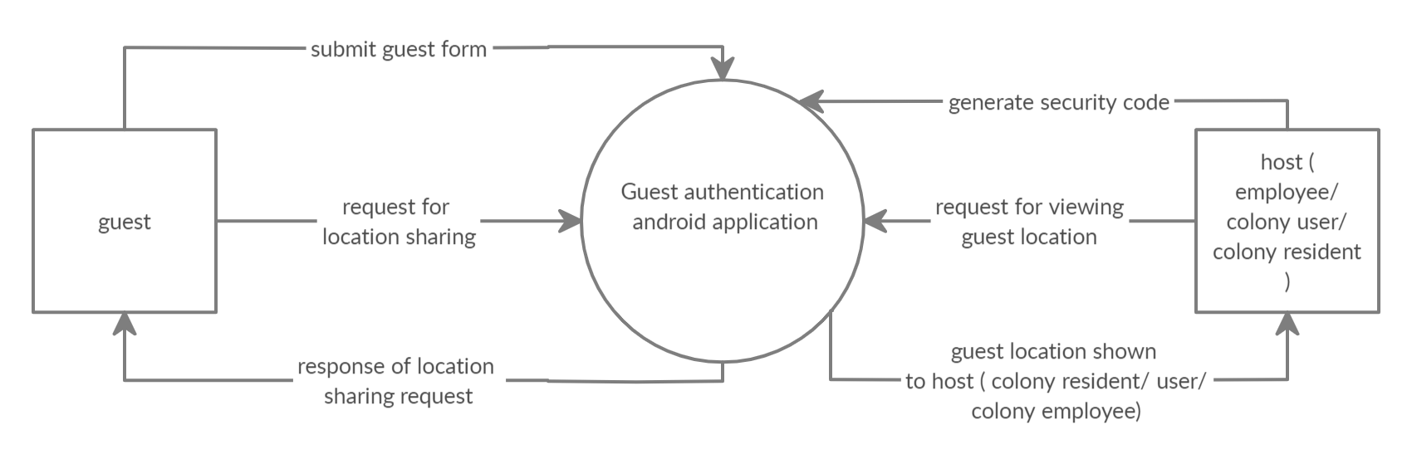
Context diagram (android app)
___ _
_______________________________

Slide 15
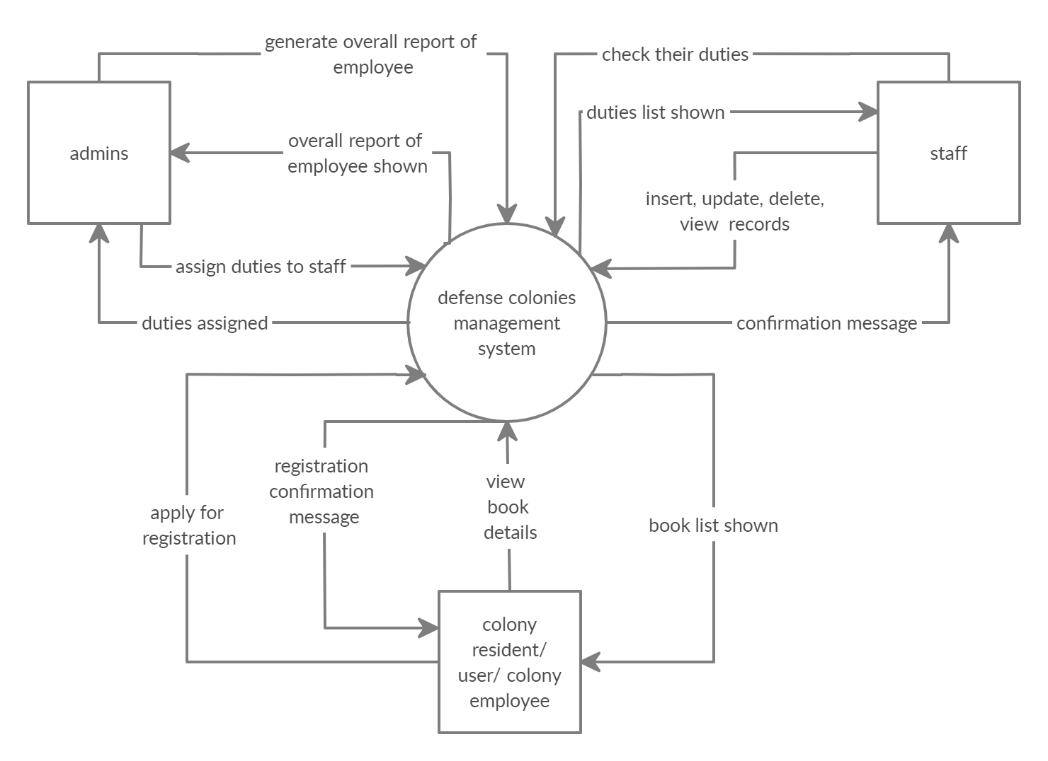
Context diagram ( ERP system)
________ _ _
_______________________________

Slide 16
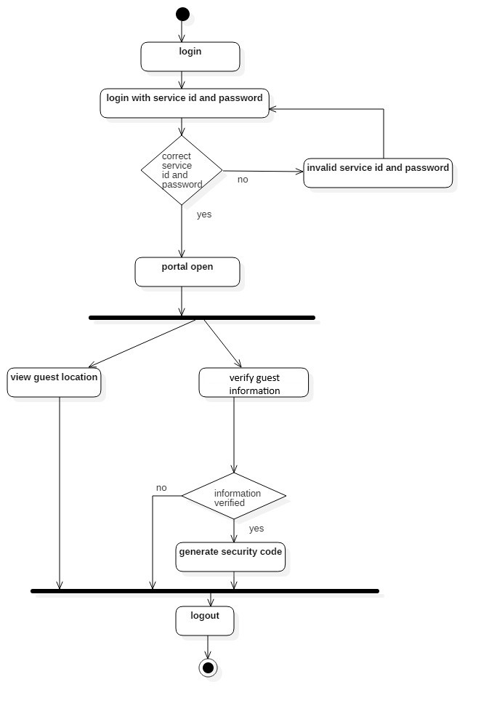
Activity diagram ( android application host(user) end)
_ _
_______________________________

Slide 17
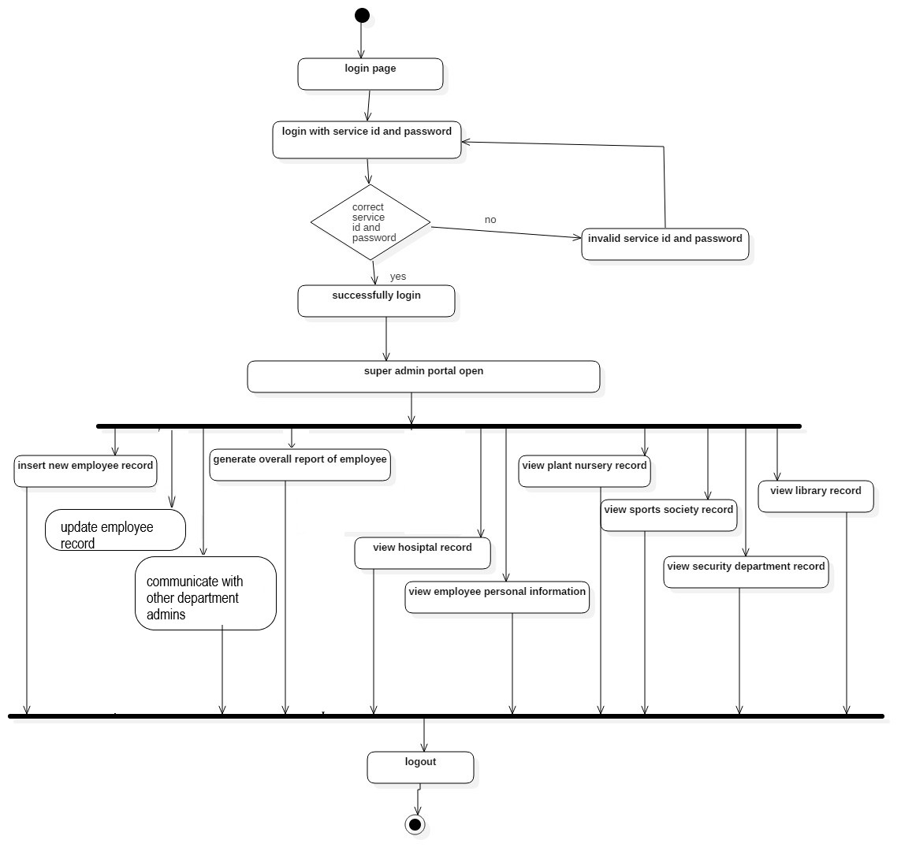
Activity diagram (super admin)
__
_______________________________

Slide 18
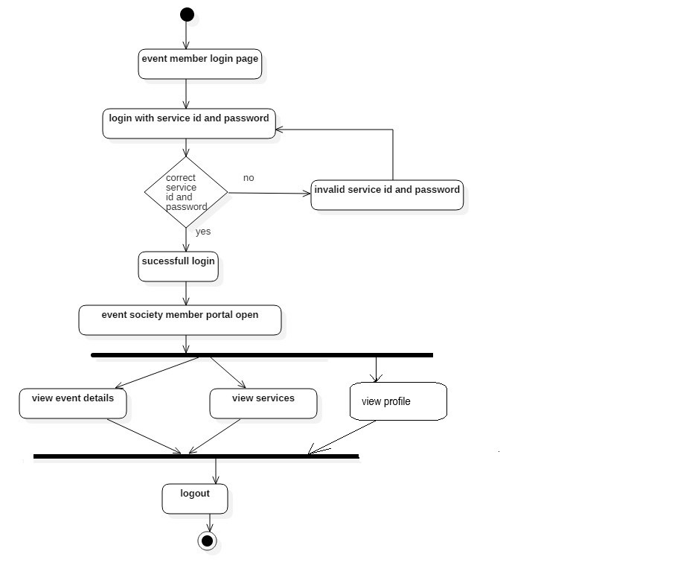
Activity diagram (event society member)
_ _
_______________________________

Slide 19
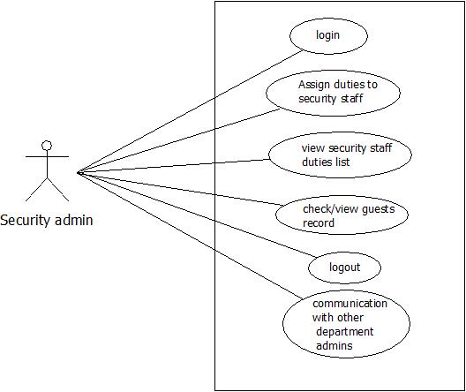
Use case diagram (security admin)
__
_______________________________

Slide 20
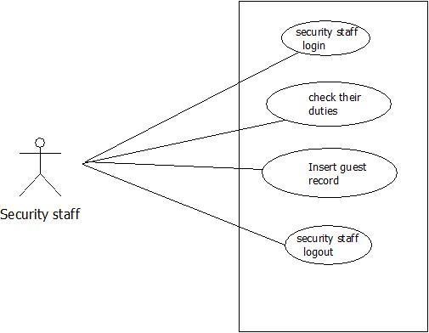
Use case diagram (security staff)
__
_______________________________

Slide 21
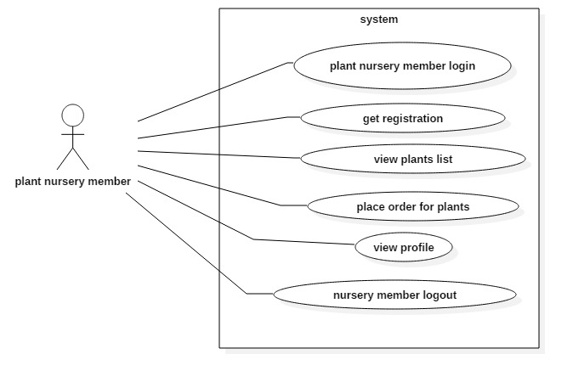
Use case diagram (Plant nursery member)
_______________________________

Slide 22
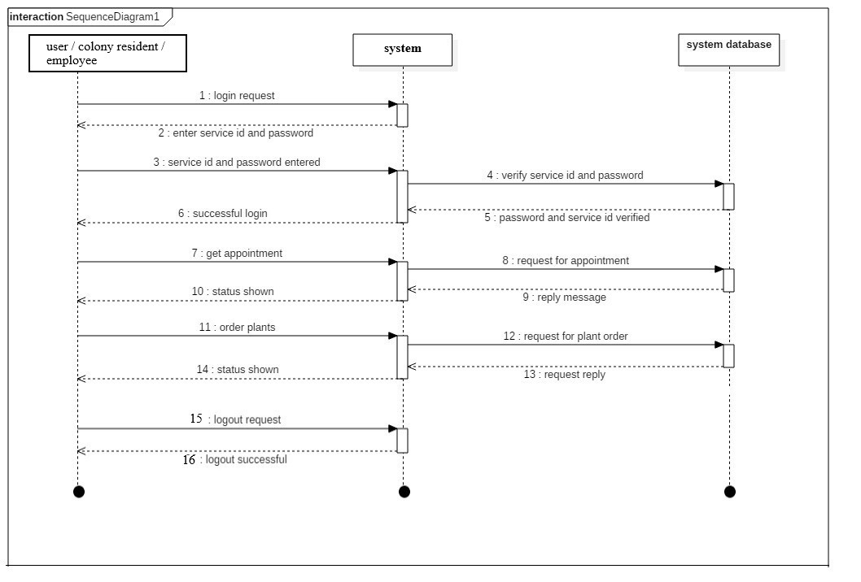
Sequence diagram (colony resident/ employee/ user)
(
_______________________________

Slide 23
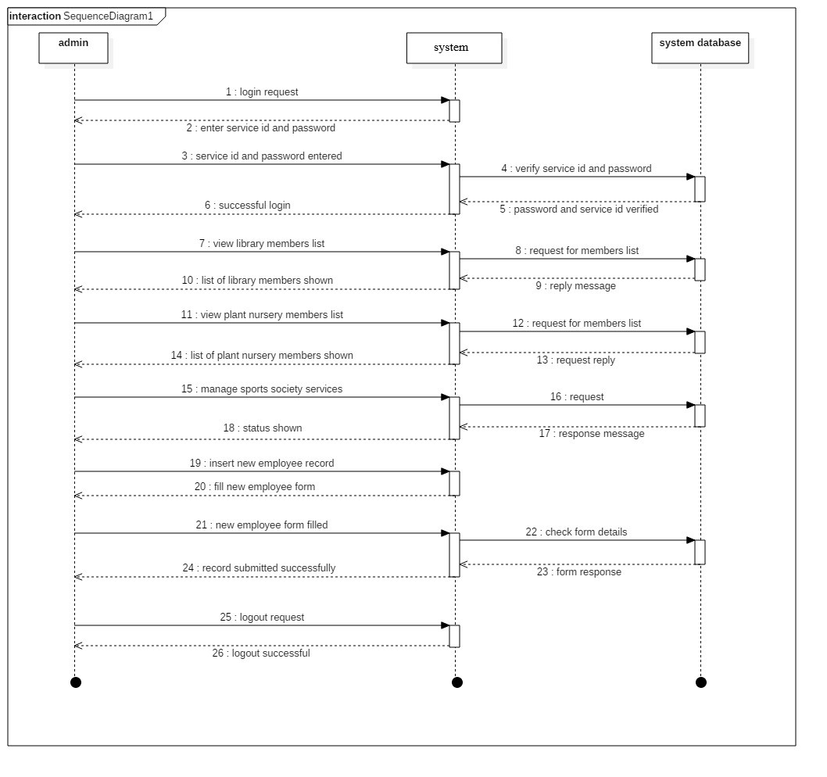
Sequence diagram ( admins)
________ __
_______________________________

Slide 24
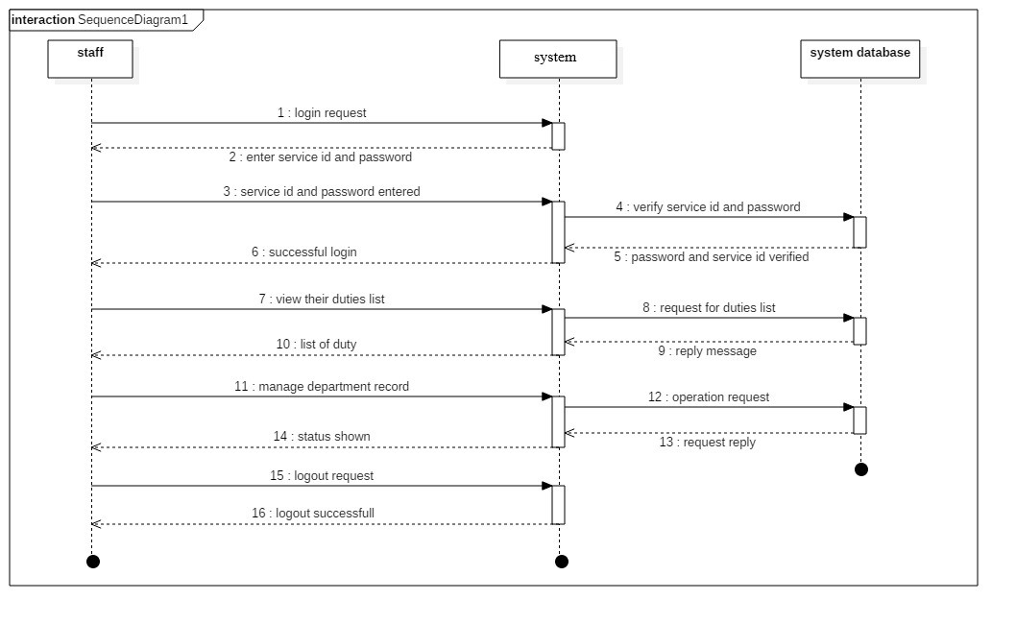
Sequence diagram (staffs)
_______ __
_______________________________

Slide 25
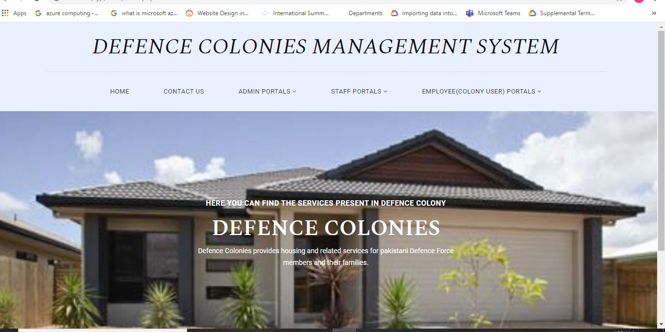
Graphical User Interface (project index page)
_
_______________________________

Slide 26
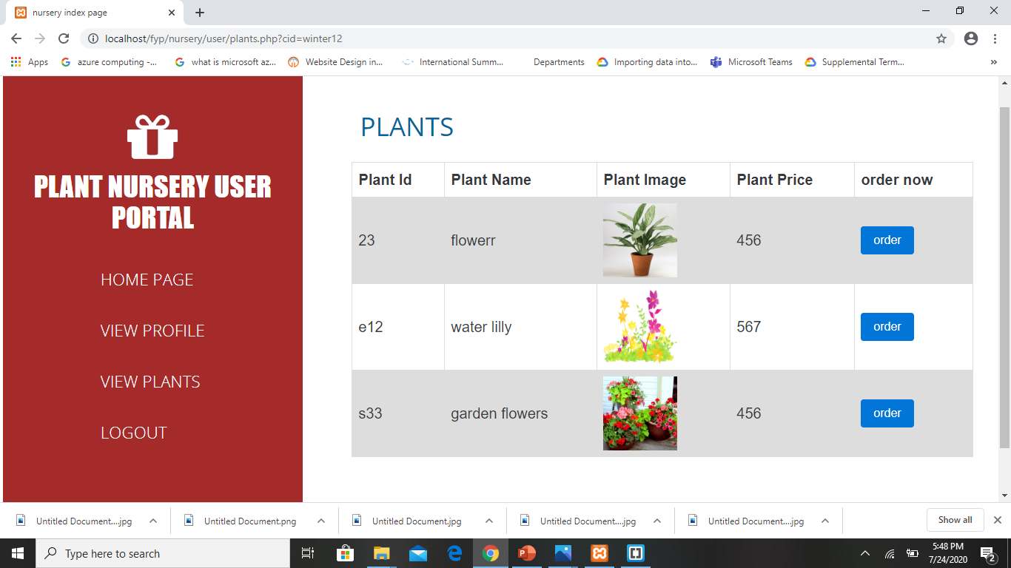
Graphical User Interface ( plant nursery user “view plants page” )
_
_______________________________

Slide 27
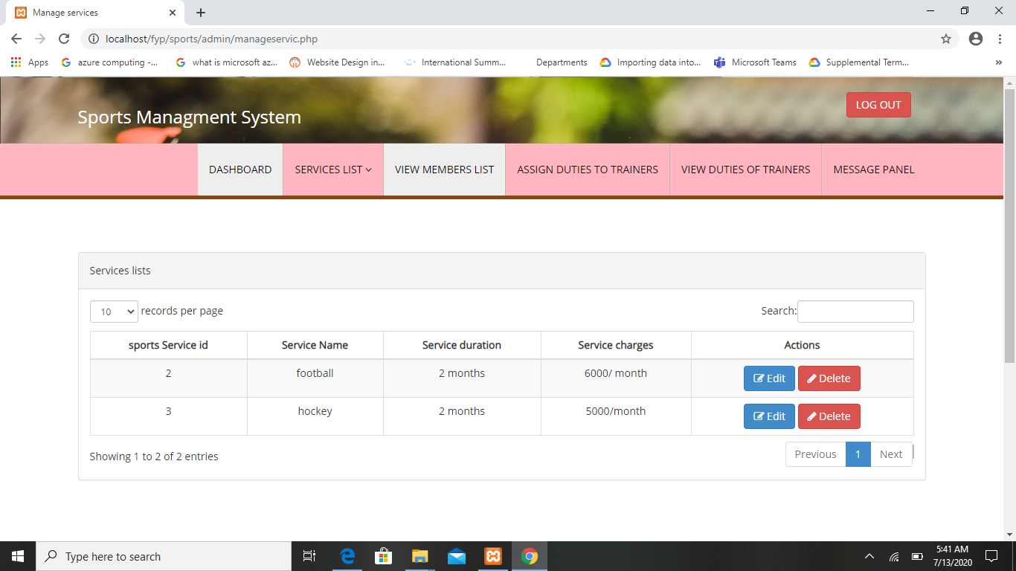
Graphical User Interface (sports society admin dashboard)
_
_______________________________

Slide 28
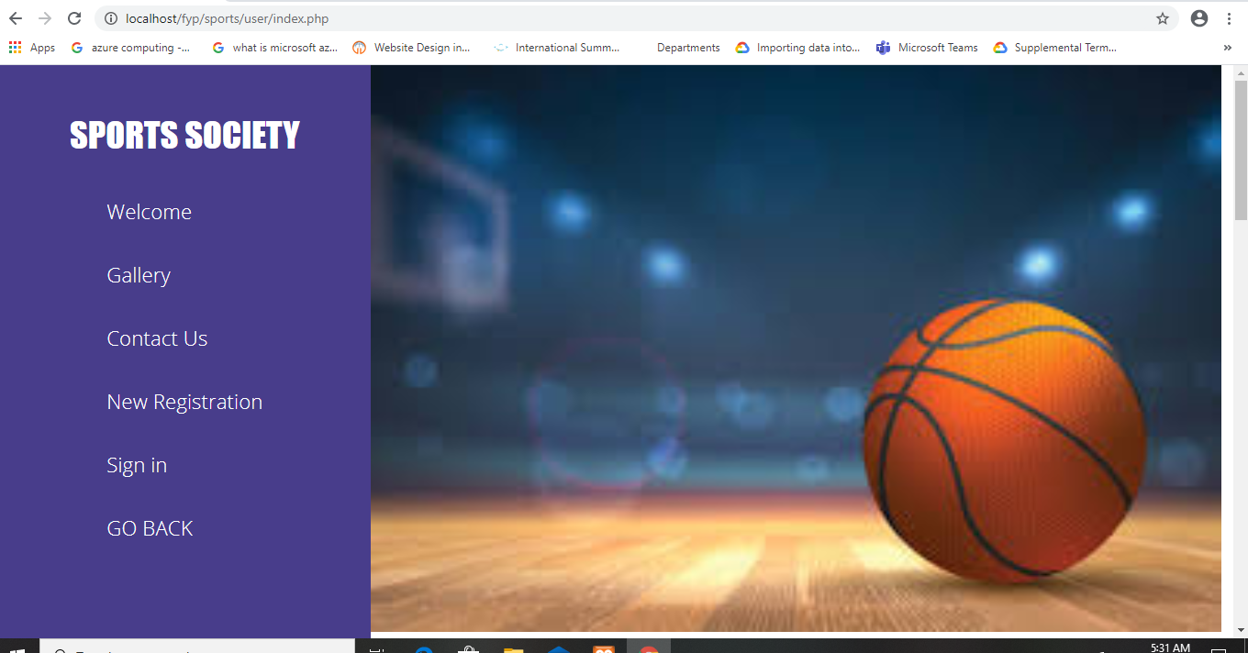
Graphical User Interface (sports society member portal index page)
_
_______________________________

Slide 29
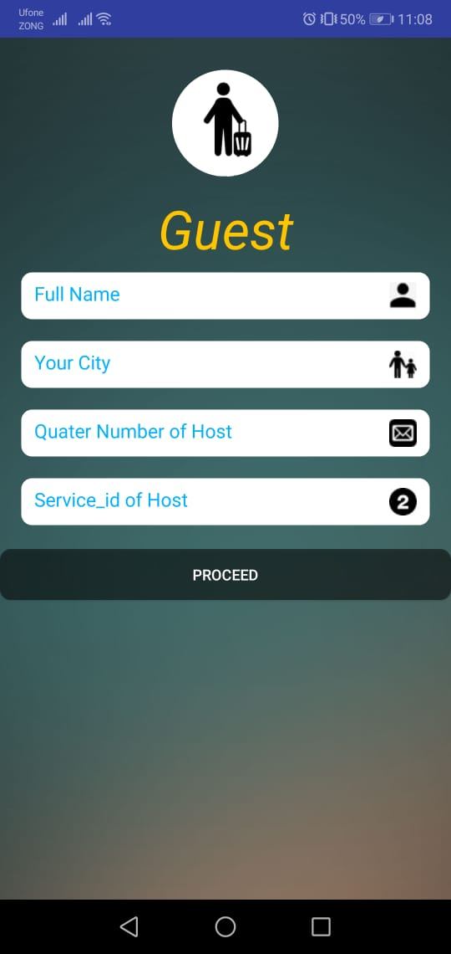
Graphical User Interface (guest interface of android application)
_
_______________________________

Slide 30
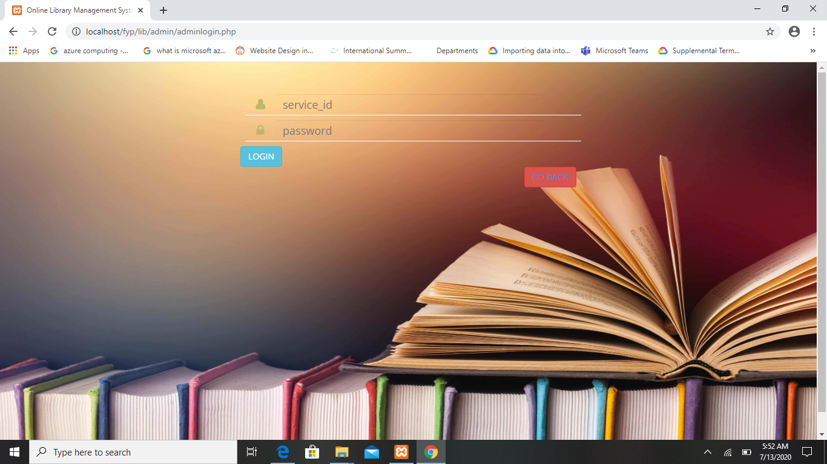
Graphical User Interface (library admin login)
_
_______________________________

Slide 31
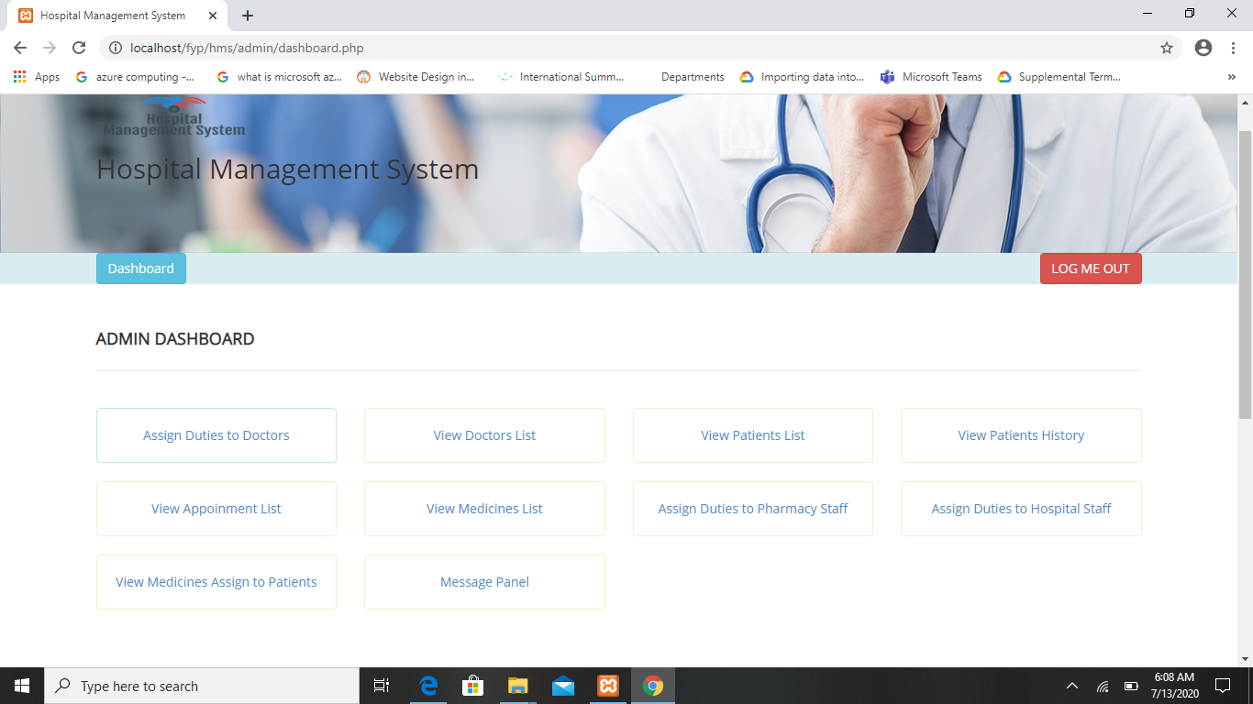
Graphical User Interface (hospital admin dashboard)
_
_______________________________

Slide 32
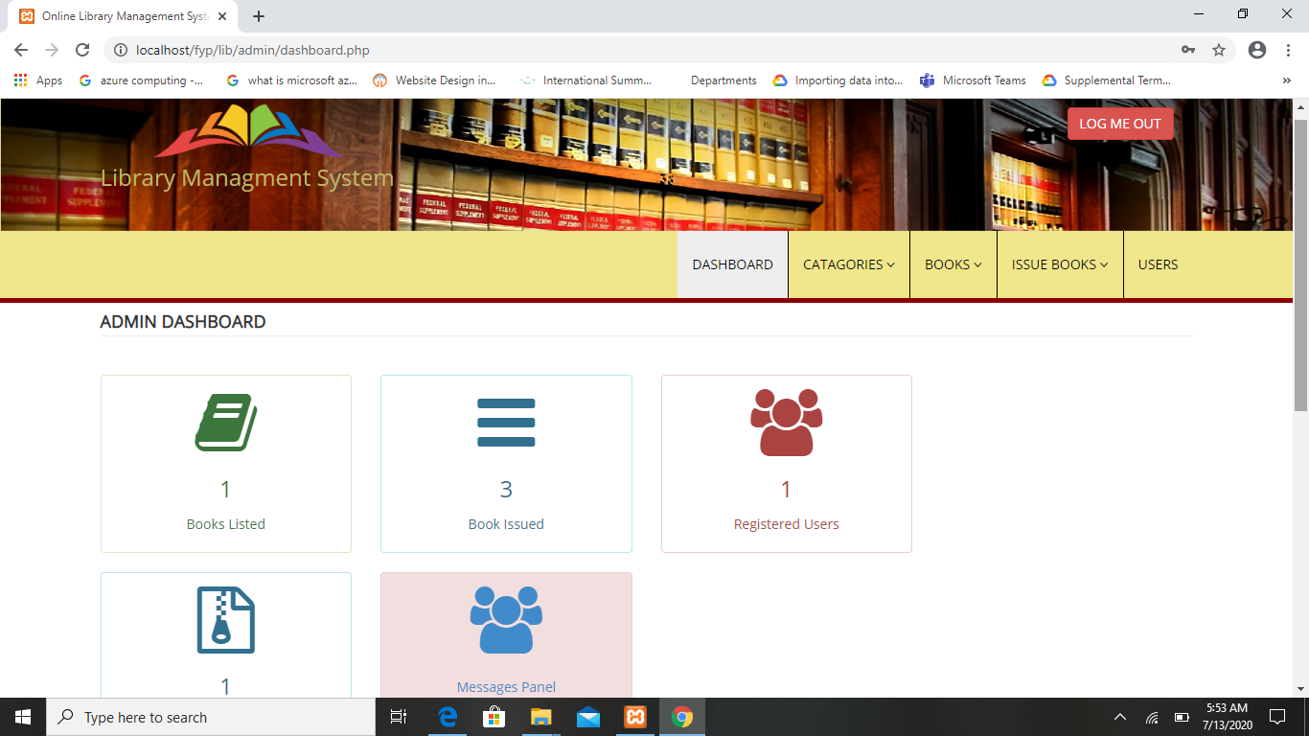
Graphical User Interface (library admin dashboard)
_
_______________________________

Slide 33
References
_
1) https://www.intelliscence.com/housing-society- management solution
2) http://www.uliving.co/
3)https://play.google.com/store/apps/details?id=com.threefiveeight.addagatekeeper&hl= en
4)https://play.google.com/store/apps/details?id=com.wowsecurity.sentinel&hl=en
_______________________________

Slide 34

______________
_______________________________

